Slide 1

Selection Statement
Prof. Dr. Md Saiful Azad

Slide 2
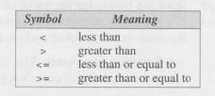
- Relational OPerators

Slide 3

- EQUALITY Operators

Slide 4

- LOGICAL Operators

Slide 5

Selection Statement
- if
- if – else
- if – else if – else
- switch

Slide 6

if Statement
- Why we need if statement?
- Syntax of if statement

Slide 7
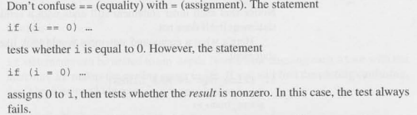
Don’t Confuse

Slide 8
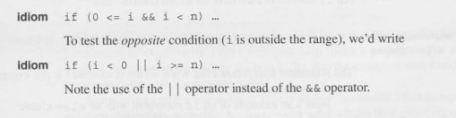
Idiom

Slide 9

Compound Statements

Slide 10

Else Clause

Slide 11
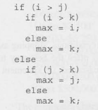
Nested if-else

Slide 12
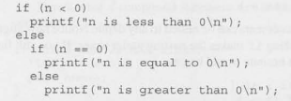
Cascaded if statement

Slide 13
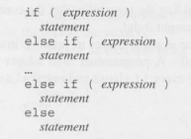
Cascade if statement

Slide 14
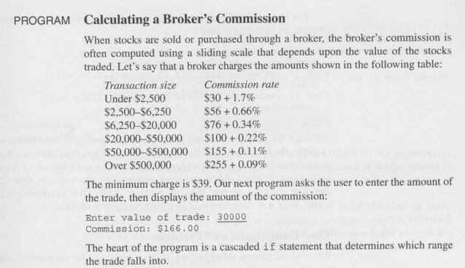
Problem

Slide 15
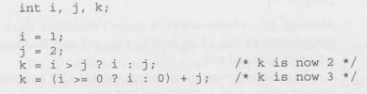
Conditional Expression

Slide 16
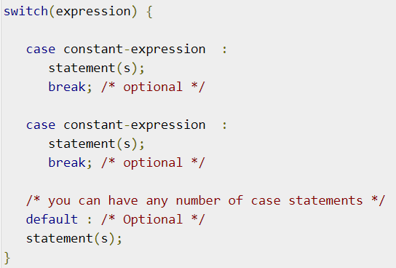
switch Statement

Slide 17
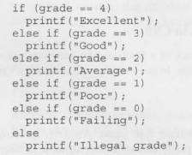
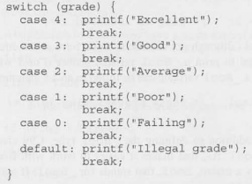
switch vs if-else

